Slide 1
INTRODUCTION TO ARTIFICAL INTELLIGENCE TERM PROJECT – PROPOSAL X’s and O’s
By:
Chandrasheker bassetti
Nikhilsai pachipulusu

Slide 2
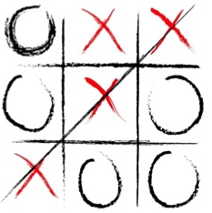
X’s and O’s
A game having two players alternately opting X’s and O’s between two horizontal and vertical lines trying to get quickest pattern of three consecutive X’s or O’s

Slide 3
OBJECTIVES
Implementation of X’s and O’s using multiple agents.
Playing the game using the designed models.
Agent forming the quickest sequence and remaining undefeated till the end is declared as our winner.
Running the Game
Winner
Training Agents

Slide 4
approach
Designing a layout which is a 3x3 grid.
Agent training about the game play atmosphere using Expectimax, Minimax, Alpha- Beta, Q learning and Approximate Q learning algorithms.
Define the agent which minimizes our utility and develop a counter strategy for our self to maximize our utility
The limitations of minimax can be overcomed by using expectimax which further expands our utility.
Further, we add a choice node to study actions of the agent and use Q learning algorithm to get the maximum utility.

Slide 5

deliverables
Algorithms developed to train agents using programming. (.py files)
Documentation manual mentioning about game implementation about various models.
Presentation on project overview.
Youtube link demonstrating the game implementation.
Github link for the project.

Slide 6
Evaluation methodology
Number of nodes expanded.
Sample Complexity.
Regret for Reinforcement learning.
Accuracy: To check results for random inputs and whether constraints are satisfied.
Correctness: To check whether the output results are correct.
Winner: The agent giving us the best result and winner.

Slide 7
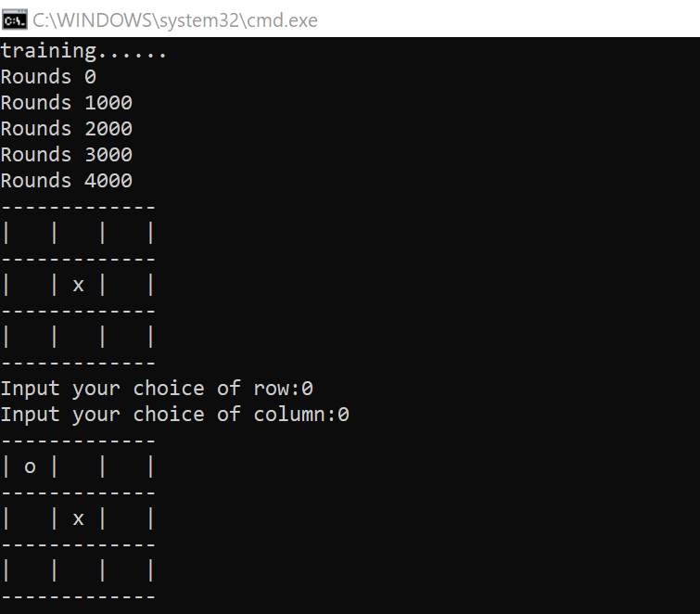
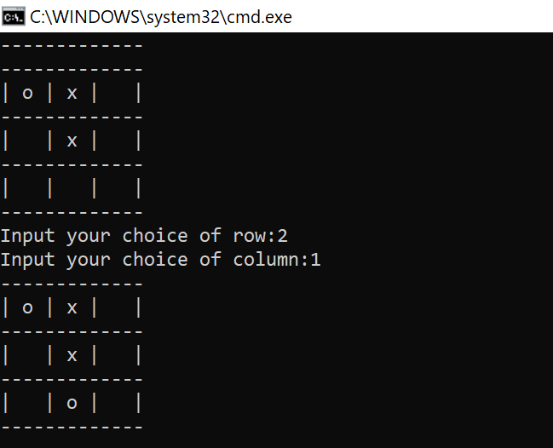
Results
When it is a Tie

Slide 8
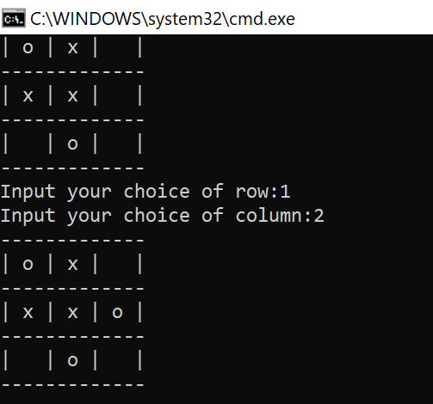
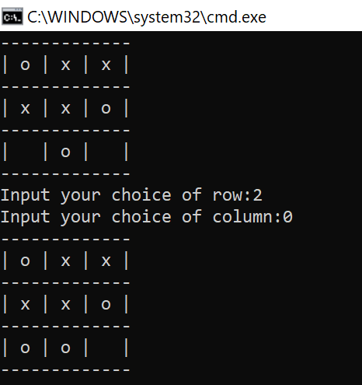
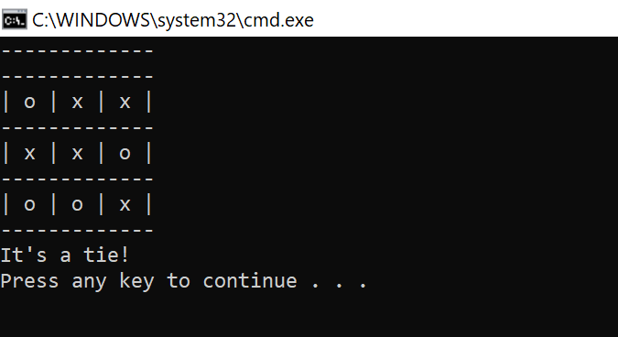
Results
When it is a Tie

Slide 9
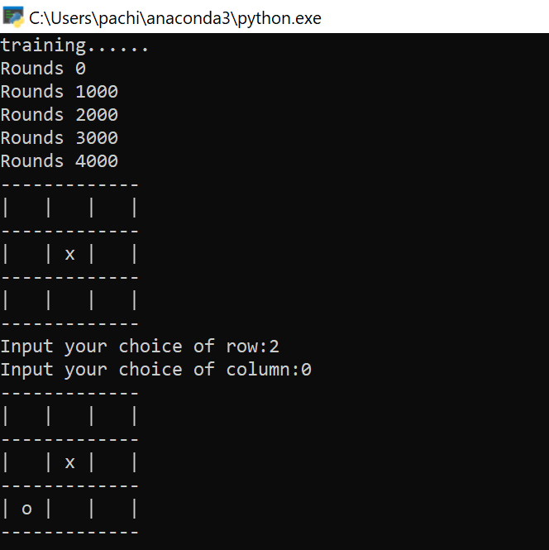
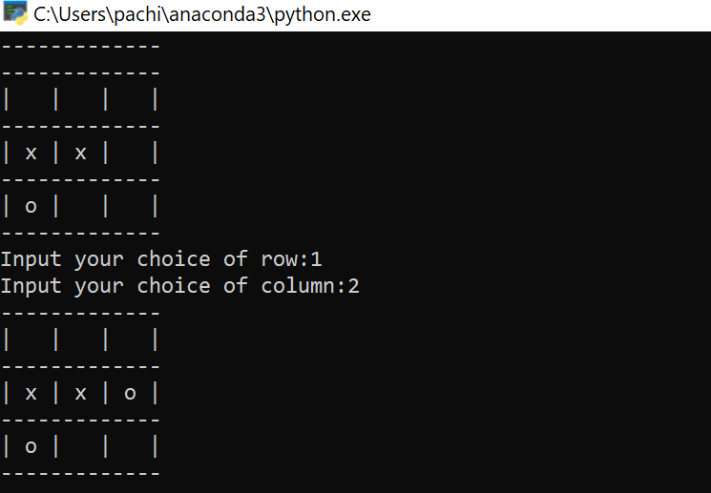
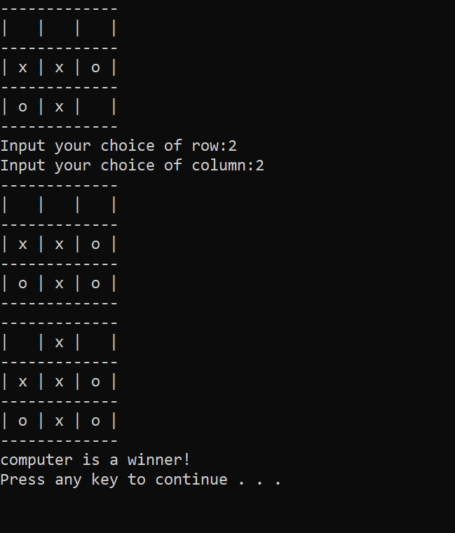
Results
When Computer Wins

Slide 10
Thank you

